Slide 1
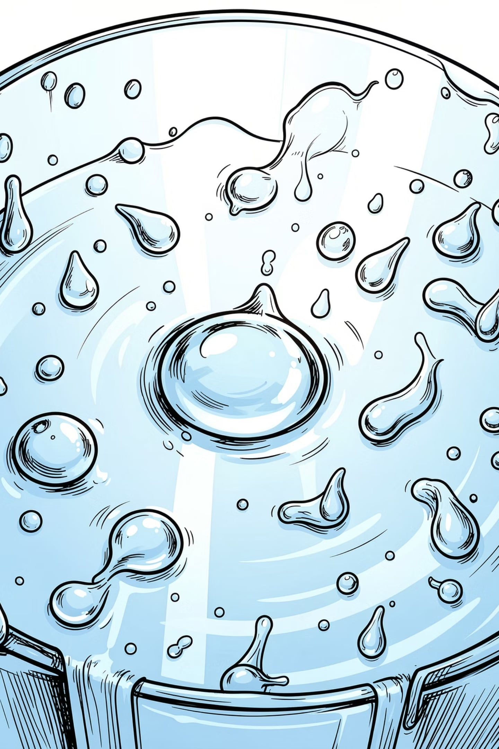

Water Potability Project Notebook
A machine learning approach to classifying water safety using physical and chemical parameters. This project explores a dataset of 3,276 water samples across 10 features, applies data cleaning, exploratory analysis, and compares four classification models to predict whether water is safe to drink.
Submitted by:
Vanshika Goel (12517148)
Neelakshi Bhuiya (12502663)
Rishita Tripathi (12513152)
Vyomica Jaiswal (12515322)
Submitted to -:
Mr Sreesh Bhat

Slide 2
Project Overview: Water Potability Analysis
This project aims to analyze water quality parameters to predict potability. We utilize various machine learning models to classify water samples as potable or non-potable, ensuring data integrity through rigorous cleaning and preprocessing.
Data Loading & Inspection
Data Cleaning
Loading the dataset and performing initial checks on its structure, columns, and basic statistics.
Identifying and handling missing values and duplicate records to ensure data quality.
Exploratory Data Analysis (EDA)
Model Training & Evaluation
Visualizing data distributions and correlations to understand feature relationships with potability.
Developing and comparing various machine learning models for accurate potability prediction.

Slide 3
Initial Data Inspection
Our dataset contains 3276 records across 10 water quality parameters.
Initial inspection revealed several missing values that require attention before analysis.
Feature
Description
ph
pH of the water (0-14)
Hardness
Water hardness (mg/L)
Solids
Total dissolved solids (ppm)
Chloramines
Chloramine levels (ppm)
Sulfate
Sulfate levels (mg/L)
Conductivity
Electrical conductivity (μS/cm)
Organic_carbon
Organic carbon levels (ppm)
Trihalomethanes
Trihalomethane levels (μg/L)
Turbidity
Water turbidity (NTU)
Potability
Water potability (0=Non-potable, 1=Potable)

Slide 4
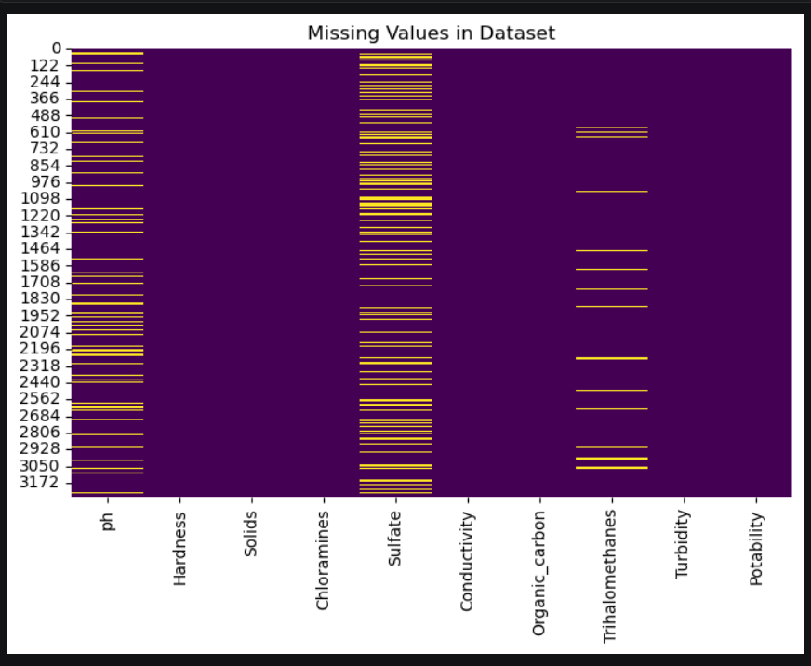


Addressing Missing Values
We identified 1434 total null values across the dataset, primarily in 'ph', 'Sulfate', and 'Trihalomethanes'. These missing values were imputed using the median of their respective columns to maintain data integrity.
After imputation, all missing values were successfully handled, and no duplicate records were found, ensuring a clean dataset for further analysis.
We identified 1434 total null values across the dataset, primarily in 'ph', 'Sulfate', and 'Trihalomethanes'. These missing values were imputed using the median of their respective columns to maintain data integrity.

Slide 5
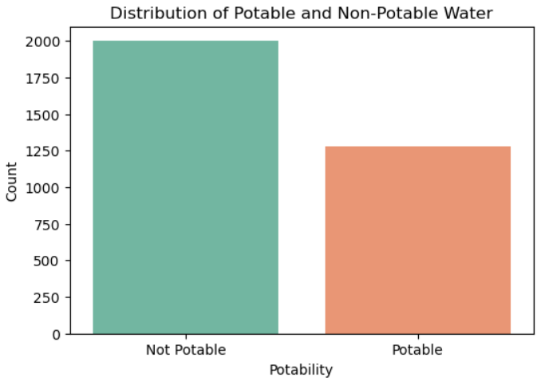
Potability Distribution
The dataset exhibits a slight imbalance, with a higher number of non-potable water samples compared to potable ones.
This distribution is crucial for understanding the classification challenge.
Approximately 2000 samples are non-potable, while 1280 are potable. This imbalance will be considered during model training and evaluation.

Slide 6
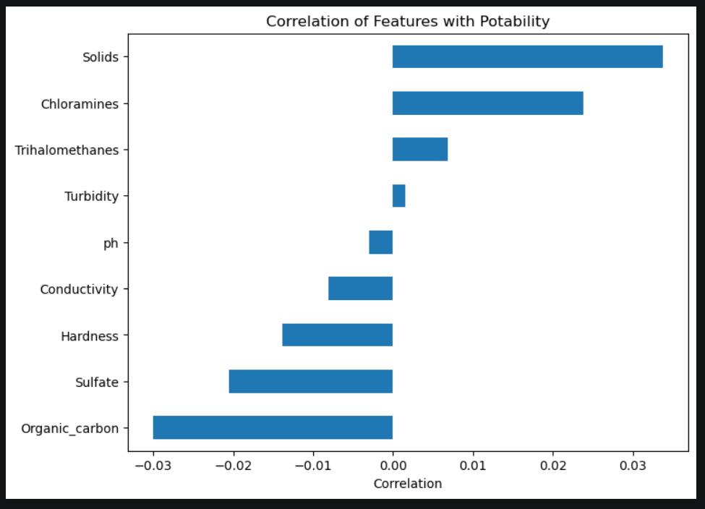
Feature Correlation with Potability
Understanding how each feature correlates with potability helps in identifying the most influential parameters for our predictive models.
Solids show the highest positive correlation, while Organic_carbon has the highest negative correlation.
The correlation values are relatively low, suggesting that potability is influenced by a complex interplay of multiple factors rather than a single dominant feature.

Slide 7
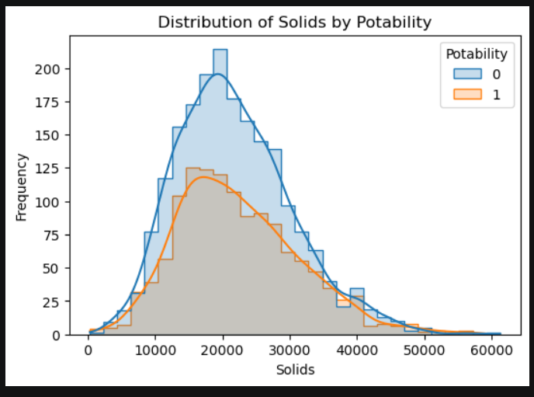
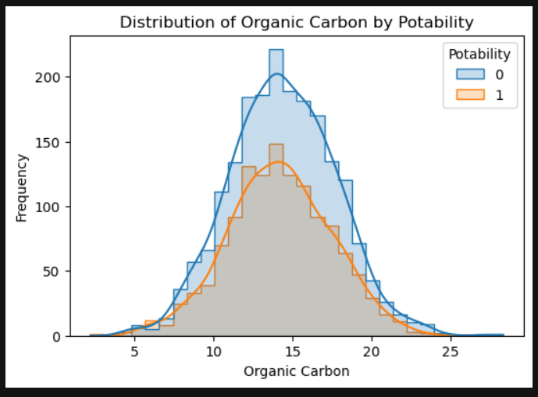

Key Feature Distributions by Potability
Visualizing the distribution of key features helps us understand their relationship with water potability.
We observe distinct patterns for Solids, Organic Carbon, Chloramines, and Sulfate.
Non-potable water samples tend to have a higher concentration of solids, with a peak around 20,000, while potable samples peak around 18,000.
Both potable and non-potable samples show similar bell-shaped distributions for organic carbon, centered around 14-15, but non-potable samples have a higher frequency.

Slide 8
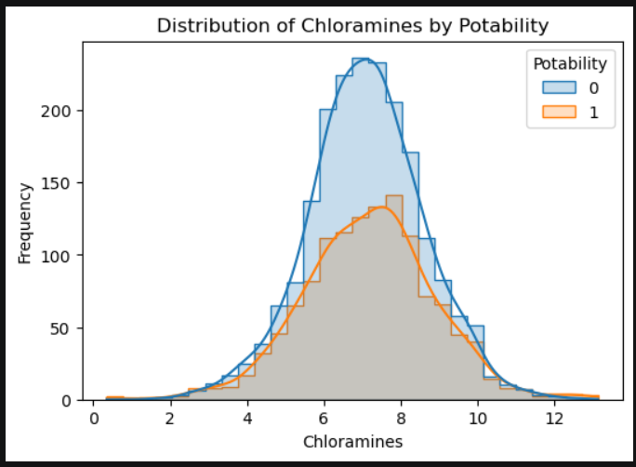
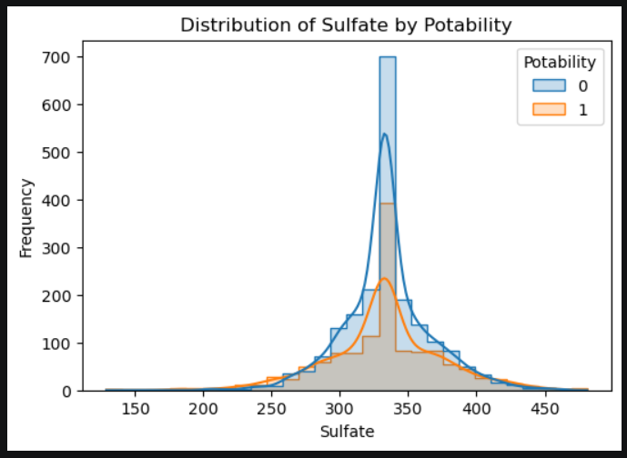
Chloramines and Sulfate Distributions
Further analysis of Chloramines and Sulfate distributions provides more insights into their role in water potability.
Chloramines distributions for both potable and non-potable water are bell-shaped and centered around 7, with non-potable samples having a higher frequency.
Sulfate levels for both categories are unimodal and slightly right-skewed, centered around 330-340, with non-potable samples showing a higher frequency.

Slide 9
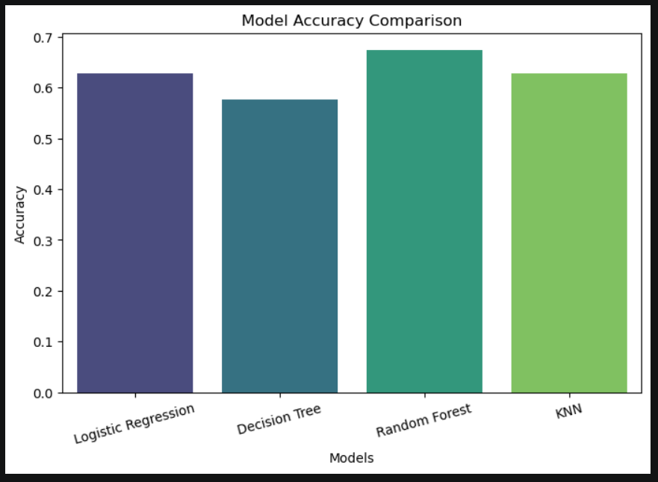
We trained several machine learning models to predict water potability,
splitting the dataset into 80% for training and 20% for testing.
Features were scaled using StandardScaler for optimal model performance.
Model Training and Comparison
Logistic Regression
Accuracy: 0.63
Random Forest
Accuracy: 0.68
KNN
Accuracy: 0.63
Decision Tree
Accuracy: 0.58
Random Forest emerged as the best-performing model with an accuracy of 0.68, demonstrating its robustness in classifying water potability.

Slide 10
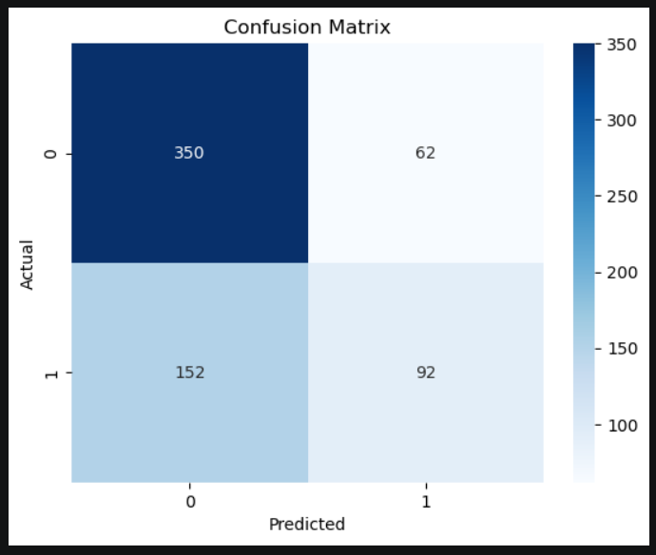


Best Model Evaluation & Prediction
The Random Forest model, with its superior accuracy, was selected as the best model. Its performance was further evaluated using a confusion matrix and classification report.
The confusion matrix indicates that the model correctly identified 350 non-potable samples and 92 potable samples. While there are some misclassifications, the model provides a solid foundation for predicting water potability.
We have successfully trained and evaluated a model for water potability prediction. The model and scaler have been saved for future use.
Thank You!

